Slide 1
AP WORLD HISTORY PERIOD 2: 600 BCE – 600 CE
Organization and Reorganization of Human Societies

Slide 2
Key Concept 2.1 Development & Codification of Religious & Cultural Traditions
Religion provides:
Community bonds & moral and ethical codes to follow
Reinforces social stratification
Merged with political rulers to justify their reign
Differences lead to conflict
Remember 2 Religions began in Period 1
Judaism & Hinduism

Slide 4
Existing Belief Systems Spread
Hebrew (Judaism) spread to eastern Mediterranean and Central Asia by the Assyrians (600 BCE) and the Romans (70 CE)
Hinduism created spiritual and social caste system and a long-term (still extant) foundation for society
Influenced by Vedic beliefs brought to India by the Indo European group – the Aryans – and merged into local tradition

Slide 5
Hinduism
Early on, beliefs passed through oral tradition
Later recorded in sacred texts, including the Vedas and the Upanishads
Hinduism Teaches that there are many manifestations of the Great Soul of the Universe (Brahman)(a trinity= trimurti)
Hindus believe themselves to be Monotheistic
Westerners believe them to be Polytheistic

Slide 6
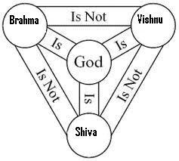

Slide 7
Hinduism
No single founder
Developed over many years in South Asia
A blend of many traditions, many from outside of India

Slide 8
Hinduism
Caste System was of central importance in India
All living things participate in the caste system
Cycles reincarnation elevate their souls to the highest level of spirituality or MOKSHA, when the soul becomes one with Braman, the Great Soul
The process can take hundreds of years and thousands of lifetimes
A soul can move up or down the ladder toward Moksha depending on Dharma (deeds) and sincerity

Slide 9
Hinduism
Karma
Teaches one’s social position in life was a sign of good or bad deeds performed in a previous life
Good karma means you fulfilled your dharma
Eg- a peasant fulfilled responsibilities of a peasant; warrior did warrior stuff well, etc.
Levels of Caste
If one moved higher on ladder they had demonstrated good karma in a previous life
If one moved down, …bad karma

Slide 10
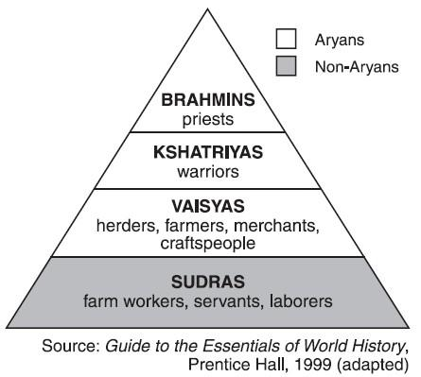
Hinduism
The Caste System
Brahmin
Priestly
Kshaytria
Ruling/warriors
Vaisyas
Sudra
Laborer
Pariah
Untouchable
Pariah

Slide 11
Hinduism
The strongest social glue of India
“The Big Constant”
Empires come and go
Many invaders
Other Religions

Slide 12
New Religions Emerge From Old

Slide 13
Buddhism
Began in South Asia (Northern India) c. 500 BCE
Founder: Prince Siddhartha Gautama
Hindu of the Brahman class
Called the Buddha or The Enlightened One
Maintained Hinduism’s belief in reincarnation
NO Caste System
ALL share the same ability to reach NIRVANA
The closer to Nirvana, the less troubled one would be by the cares of this world

Slide 14
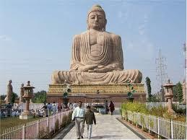
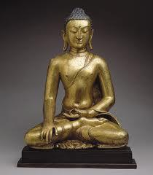
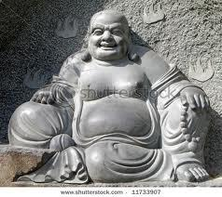

Slide 15
Buddhism
Main teachings maintain that the point to live and to achieving Nirvana was to bring about the end of suffering
The Four Noble Truths
In life, there is suffering
Suffering comes from selfish desire
Those seeking the path to nirvana should strive to end suffering
Suffering can end by following the Eight-Fold Path

Slide 16
Buddhism
The Eight-Fold Path
Right View
Right Intention
Right Speech
Right Action
Right Livelihood
Right Effort
Right Mindfulness
Right Concentration

Slide 17
Buddhism
The Buddha taught that questions about the existence of God were immaterial.
Those who truly followed the Eight-Fold Path would discover the truth regarding a Supreme Being when they reached nirvana

Slide 18
Christianity
Began in Southwest Asia in the first century CE
Founder: Jesus of Nazareth, a Hebrew
Preached salvation through faith in him, the Son of God
Jesus’s teachings were recorded in the Gospels and developed in other writings

Slide 19
Similarities Between Buddhism & Christianity
Both emerge out of ancient religions
Hinduism → Buddhism
Judaism → Christianity
Both subvert social and gender norms (at first)
Equality of believers
Attract lower classes & women (Buddhism also popular amongst merchants)
Both spread by merchants & missionaries along trade routes
Both are universal faiths- can be practiced by all people
Both offer alternative lifestyles- monasticism

Slide 20
Spreading Faiths
Both Buddhism and Christianity gained more followers outside of their region of origin
Buddhism spread east across the Indian Ocean and by the Silk Roads by missionaries and merchants
Message of peace very appealing
Buddhism changed to a Salvationist faith as it spread east – Mahayana
Theravada – closer to original form not quite atheist but…

Slide 21
Spread of Universal Religions

Slide 22
Spreading Faiths
Christianity also gained popularity beyond it’s original birthplace
Initially seen by the Roman government as disloyal to emperor and Christians were persecuted
Emperor Constantine officially accepted Christianity in 4th century CE
Spread west by missionaries and merchants
Eternal life and equality very appealing
Was the “glue” that held Europe together during the chaos after the fall of Rome

Slide 23
Confucianism
During the Warring States period in China (c. 500 BCE)
Founder: Kong Fu Zi, (Confucius)
Teaching compiled post-mortem in The Analects
Set a clear set of rules for moral behavior and family and political order
Filial Piety
utmost respect for parents
Obedience to those in political control

Slide 25
Confucianism
Five Relationships
Ruler to Subject
Father to Son
Elder Brother to Younger Brother
Husband to Wife
Friend to Friend
Shaped family and gender relationships as well as political and social relationships
Patriarchal society

Slide 26
Confucianism
Confucius did not promise an eternal reward
Confucianism is a philosophy for this life, not a religion
By 1200 CE, developed into Neo-Confucianism
Confucianism lasted and held China together for centuries

Slide 27
Daoism
Also spelled Taoism
Founder: Laozi – best known Taoist philosopher
Developed around the same time as Confucianism in China and for the same reasons
Teaches
of the close connections between humans and nature
Balance and harmony in all things
Deep respect for ancestors

Slide 28
Daoism
Encourages humans to look away from human creations and find peace and balance in nature’s examples
Influential in Chinese medical practices such as acupuncture
Architecture blends into the landscape
Best known symbol – Yin-Yang
Neo-Confucianism incorporated some ideas from Taoism as well as Buddhism

Slide 29
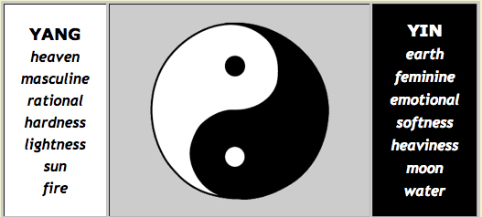

Slide 30
Animism and Shamanism
Do not have written guidelines to shape adherents beliefs
Most began in the oral tradition before writing
Both hold great reverence for deceased ancestors who guide the lives of the living
Continue to be popular in areas of Africa, Andes and some parts of the East Asia and Native America
Animism
Shamanism

Slide 31
Animism and Shamanism
Animism
Belief that the natural world has spiritual powers
All things have a spirit and all spirits must be appeased
Shamanism
Belief that human spirit guides (shamans) are contacts between this world and the spirit world
Shamans are also believed to have the power to heal physical and spiritual illnesses

Slide 32
Belief Systems and Gender Roles
Belief systems play a major part in development of gender roles
Men dominate the leadership of all major religions
Women sometimes served in similar capacities as priestesses, prophets and missionaries
Both Buddhism and Christianity offer women opportunities to serve the religious communities as nuns

Slide 33
Classical Cultures Develops

Slide 34
Classical Civilization and the Arts
This era developed many long-lasting forms of arts, including architecture, literature, paintings and sculpture
Greek plays and histories influenced literature around the Mediterranean region and Western civilization
Theatrical acting – dramas, comedies, tragedies that reflect the human condition
Histories of their wars with the Persians and themselves became the “template” for western writing
Believed that history was a good way to teach life’s lessons regarding good and bad behavior and their consequences

Slide 35
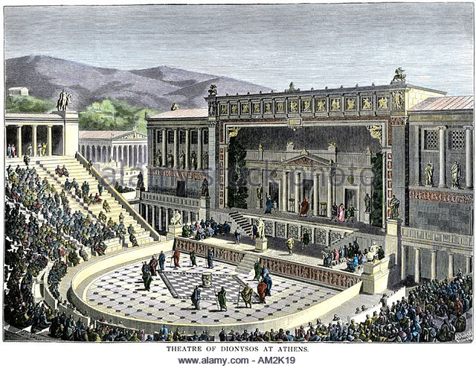

Slide 36
Classical Civilization and the Arts
Indian epic poems continue to influence literature in South Asia with stories of self-sacrifice and devotion to duty and to the Hindu faith
Ramayana
Bhagavad Gita

Slide 37
Classical Civilization and the Arts
Architecture from this era had long-lasting influence
In China, India, Mesoamerica, and Mediterranean region
In all classical regions, monumental building projects supported both the government and religious faith
Mesoamerican temples looked very similar to Mesopotamian ziggurats

Slide 38
Pantheon in Rome (I took this ☺ )- arches, columns, colored marble, mosaic art

Slide 39
Classical Civilization and the Arts
Greek and Indian architectural styles blended as a result of Hellenism
Religion themes prevailed in all regions
Greek forms of sculpture reflected Hellenism as well
Asian sculptures venerated Hindu, Buddhist or Confucian beliefs
Daoist artists painted nature scenes to show their devotion

Slide 40
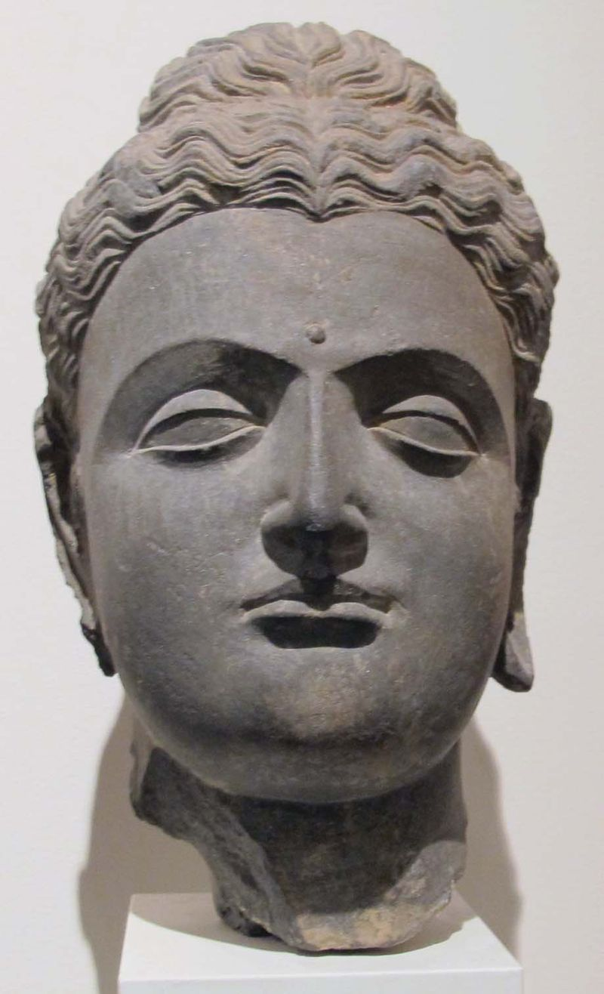
Greco-Buddhist sculpture Northern India, 1st – 2nd c. CE

Slide 43
Key Concept 2.2- Classical Empires
Empire- a political system where one state dominates another state, or series of states
Methods of Administration:
Centralized governments and bureaucracies
Elaborate legal systems
Maintain power/prestige through:
Diplomacy with other powers
Supply lines for troops
Building roads and walls
Drawing troops & officers from local population

Slide 44
Key Concept 2.2 Development of States and Empire
China
Zhou (Mandate of Heaven, longest dynasty, ends in 256 BCE and leads to Warring States Period)
Qin (221-206 BCE)
Short but important
Shi Huangdi 1st Emperor,
Unified China for 1st time
Legalism (Harsh)
Centralized government
Began Great Wall (finished by Ming)
Standardized weights and measurements
Tomb of Terracotta Warriors

Slide 45
Key Concept 2.2 Development of States and Empire
China
Han (206 BCE – 220 CE)
Golden Age – peace, stability, achievements
Centralized government
Confucianism – some social mobility
Civil Service Exam – merit based bureaucracy
Began Silk Roads, linked to Europe
Capital city – Chang’an
Patriarchy
Merchants looked down on
Achievements: coined $, paper, clocks, compass

Slide 46
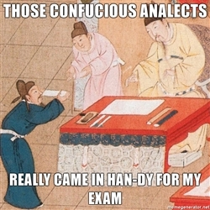

Slide 47
Key Concept 2.2 Development of States and Empire
India – (usually politically decentralized, empire is NOT the norm)
Mauryan (322 – 185 BCE)
Founder: Chandragupta Maurya united subcontinent
Larger of 2 early empires
Grandson Asoka converted to Buddhism and spread religion; Rock Pillars
Gupta (320 – 600 CE)
Golden Age (Arabic Numerals, concept of zero, base 10)
Hinduism and Sati (patriarchy)

Slide 48
Pillars of Ashoka (stone columns with Ashoka’s Laws/Edicts inscribed)

Slide 49
Key Concept 2.2 Development of States and Empire
Mediterranean Empires
Persian Empires (present day Iran)
Achaemenid (550 – 330 BCE)
Cyrus the Great built largest empire in the world
Zoroastrianism; religiously tolerant
Royal Road System (1,600 miles)
Strong military, used satraps (regional leaders) to help rule
Conquered by Alexander the Great
Parthian (247-224 CE)
Center of trade on Silk Road, often fought with Roman Empire
Sassanid (224 – 651 CE)
Last Pre-Islamic Persian Empire
Considered world power with Rome/Byzantines

Slide 50
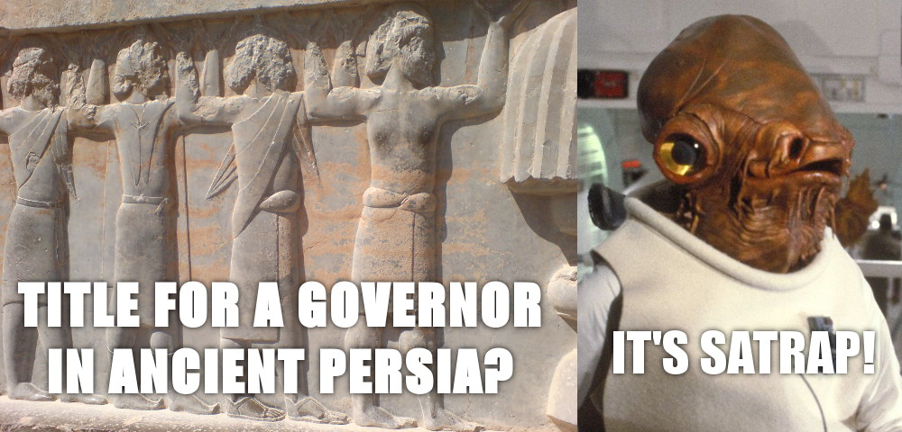

Slide 51
Key Concept 2.2 Development of States and Empire
Mediterranean Empires
Greece
City-states, not unified, many types of government but had common language and religion
Geography: Mountainous, Importance of the seas and trade
Athens (Democracy, philosophy, Parthenon) vs. Sparta (totalitarian oligarchy, military)
City-states unite to defeat Persia
Peloponnesian Wars (Athens vs. Sparta – 431-404 BCE)
Wars weaken Greece and make way for Phillip II of Macedon (Alexander the Great’s Father)

Slide 52
Key Concept 2.2 Development of States and Empire
Mediterranean Empires
Hellenistic Empire (740 – 146 BCE)
Alexander the Great
Conquered Greece, Egypt, Persia and Northern India
Golden Age (libraries, geometry, cities – Alexandria, Egypt)
Syncretism: Greco-Buddhism in South Asia
Died at age of 33 in 323 BCE
Empire broke into pieces

Slide 53
Key Concept 2.2 Development of States and Empire
Mediterranean Empires
Roman Empire
Began with Romulus & Remus
Republic (citizens have say in government) (500 BCE – 30 BCE) with Patricians vs. Plebeians and the Senate
Punic Wars vs. Carthage (Hannibal)
Julius Caesar assumed dictatorship 48 BCE
Augustus Caesar and the Pax Romana (Golden Age)
Law (12 Tables), engineering (roads, aqueducts, walls on the border), Silk Road, use of slavery
Christianity becomes official religion 380 CE

Slide 54
Key Concept 2.2 Development of States and Empire
American Empires
Mayan Empire (250 – 900 CE)
City-states in Mesoamerica (central America)
Achievements: calendar, step pyramids, glyphs, astronomy, terrace farming
Teotihuacan
One of the biggest cities in classical era
Traded with Mayan
Human sacrifice
Complex bureaucracy and pyramids
Moche: Andean (100 – 800 CE)
Gold, architecture, irrigation, terrace farming, human sacrifice

Slide 55
Key Concept 2.2 Development of States and Empire
Common Attributes of Classical Empires
Large empires required advanced bureaucracies
1st major trade centers developed (cities) glorified empires
Food production was key
Widespread slavery
Patriarchy and social hierarchies based on occupation
Comparisons of Empires
Maya & Gupta (concept of zero)
Rome & Han (Silk Roads)
Greeks & Romans (dependence on slavery)
Mayans & Greeks (city-states)

Slide 56
Key Concept 2.2 Development of States and Empire
Common Attributes of Classical Empires
Large empires required advanced bureaucracies
1st major trade centers developed (cities) glorified empires
Food production was key
Widespread slavery
Patriarchy and social hierarchies based on occupation
Comparisons of Empires
Maya & Gupta (concept of zero)
Rome & Han (Silk Roads)
Greeks & Romans (dependence on slavery)
Mayans & Greeks (city-states)

Slide 57
Key Concept 2.2 Development of States and Empire
Comparing Roman and Han Empire
Rome |  | Han
Heavy reliance on slavery | Social Structure | Heavy reliance on peasants (respected)
Centralized | Political | Centralized, merit based bureaucracy based on civil service exams
Trade along Silk Road and Mediterranean Sea | Economic | Trade along Silk Roads and Indian Ocean Trade
Absorbed foreign religion in later years (Christianity) Achievements in law & engineering (roads) | Culture | Absorbed foreign religion in later years (Buddhism) Achievements include roads & civil service exam

Slide 58
Key Concept 2.2 Development of States and Empire
Collapse of Classical Empires
Over-extension of borders
Internal disruptions
Breakdown of imperial authority; political corruption
Failing economies- unsustainable economic inequality
Peasant revolts against landlords (Han - Yellow Turban Revolt); resistance to high taxes
External Invasions
Rival empires and nomadic
331 BCE- Achaemanid Empire (Alexander the Great)
476 CE Roman Empire (Huns, Goths, Vandals)
220 CE Han (Xiongnu)

Slide 59
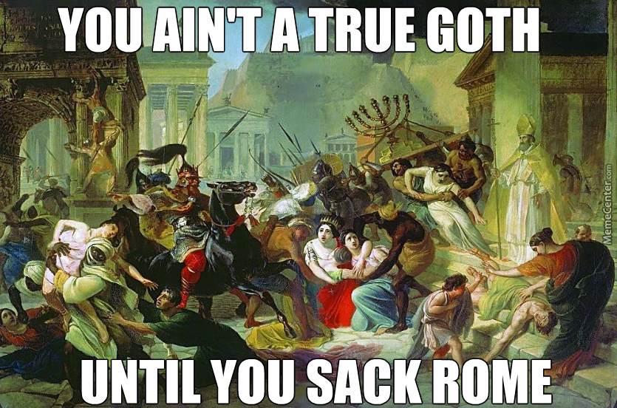

Slide 60
Case Study on Collapse: Rome
Fall of the Roman Empire... Crash Course World History #12

Slide 61
Key Concept 2.3 Emergence of Transregional Networks of Communication and Exchange
Silk Roads
Land based trade routes
Chinese monopoly on silk (desirable and expensive)
Goods Traded
From E. Asia to W: Silk, horses, spices, furs, rice,, porcelain
From S Asia to E & W: cotton, spices, sandal wood, rice
From C. Asia to E, W & S: dates, almonds, fruit, camels, horses
From points west (Med. Sea): glass, gold, olive oil, perfumes
Technology: qanat system (irrigation, transports water from below ground to surface in arid regions – C. Asia to SW Asia)
Buddhism spreads from India to China to Korea to Japan
Disease spreads (Plague)

Slide 62
Key Concept 2.3 Emergence of Transregional Networks of Communication and Exchange
Indian Ocean Trade
Largest sea routes until 1400s
Connected SE Asia, China, Africa, Middle East and South Asia
Depended on monsoon winds
Creates diasporic communities of merchants waiting for winds to turn
New technology
Dhows – small but seaworthy trading ships used by Arab merchants
Lateen sail - triangular

Slide 63
Indian Ocean Trade and Silk Roads

Slide 64
Key Concept 2.3 Emergence of Transregional Networks of Communication and Exchange
Trans-Saharan Trade Routes
North Africa to Mediterranean coastal cities
Goods Traded
From Africa: Gold , salt, ivory, animal hides and slaves
From Med.: dates, cotton, dyes, cloth, leather, glass
Introduction of camel 1st Century CE, saddle 300 CE

Slide 65
Key Concept 2.3 Emergence of Transregional Networks of Communication and Exchange
Other Notable Trade Routes
Mediterranean Sea (Greeks, Phoenicians, Burburs)
Sub-Saharan Trade Routes (Bantus connect sub-Saharan Africa to E. Africa)
Black Sea
Who’s Missing? The Americas
Why? Smaller scale trade, fewer large domestic animals, no wheel, geography N-S made trade difficult
Mayan and Teotihuacan in Mesoamerica and within Moche

Slide 66
Period 2 Review Questions
1. Monasticism is a characteristic of which of the following religions?
Judaism
Hinduism
Confucianism
Buddhism

Slide 67
Period 2 Review Questions
2. In which of these societies were merchants and traders placed in a lower social class than farmers and artisans
Han China
India
Japan
Rome

Slide 68
Period 2 Review Questions
3. After the Peloponnesian War, the Macedonians took control of Greece and spread Greek culture throughout much of the known world under the leadership of
Julius Caesar
Hannibal
Alexander the Great
Pericles

Slide 69
Period 2 Review Questions
4. In China, Confucianism emphasized the idea that
Equality should exist among all members of society
Salvation could be attained by prayer, meditation and good deeds
Harmony could be achieved by the proper behavior of each member of the family or society
People are fundamentally evil and need to be led by a strong central government

Slide 70
Period 2 Review Questions
5. In comparing the Han Dynasty with the Roman Empire, which of the following statements is NOT accurate?
Both the Han Dynasty’s and Roman Empire’s economies suffered as a result of military spending
While Rome was successful at spreading its culture across a wide area, the Han were unable to diffuse their culture to neighboring lands
While both societies were run by centralized governments, Rome gave significant autonomy to local officials
While the Chinese were able to re-establish their imperial empire, Rome was never restored to its former status.

Slide 71
Period 2 Essay Question
Compare the political and social impacts of two of the following belief systems.
Hinduism, Confucianism, Christianity

Slide 72
Period 2 Essay Question
Compare the reasons for and the outcomes of the fall of TWO of the following classical civilizations
The Roman Empire
Han China
Gupta India

Slide 73
Period 2 Essay Question
Compare the political and cultural characteristics of two classical empires.

Slide 74
Period 2 Essay Question
Analyze the cultural and political changes and continuities in ONE of these civilizations during the early classical era from 1,000 to 1BCE
Rome
China

