Slide 1
Foods
Review
Foods 2
Ms. Stevens

Slide 2
Start Recipe-How do you know it’s a good recipe?
All ingredients are listed
The yield is listed
All steps are listed
Cooking directions are clear
Equipment needed is listed

Slide 3
Kitchen Basics
- The first thing that you do when you get to your kitchen is: put your hair up, put on an apron then wash your hands.
- Clean towels are found: drawers under the black microwave beside the washing machine. Dirty towels go: washing machine.

Slide 4
Listed below are the steps in washing dishes. Put them in the correct order by placing a number from 1 to 7 in front of each step.
__7___ Air dry or dry with a clean towel
__1___ Scrape food particles off dishes
__5___ Wash in hot, soapy water
__4___ Wash in the correct order by groups
__3___ Pre-rinse dishes lightly
__6___ Rinse in hot water
__2___ Sort and stack dishes by groups
GRAINS
VEGETABLES
FRUITS
OILS
MILK
MEAT & BEANS

Slide 5
Refills
Extra dish soap, hand soap, sanitizer is located in the washer and dryer sink area.
We do not throw away the bottles of sanitizer, we REFILL them!
Please use the paper towels sparingly. Go GREEN!!!!

Slide 6
Food Safety
-Keep hot foods hot and _cold foods cold .
-The temperature danger zone is: 40-140 . Which means: bacteria multiply rapidly between those temps. All food should be kept below 40 or above 140.
-Do not let foods sit out for longer than: 2 hours .
-Thaw foods in the Refrigerator or microwave.
-When cooking meat, the internal temperature should reach at least: 160* .

Slide 7
Kitchen Safety
- The first aid kit is located: In the front of the room.
- If a grease fire should ignite, do not pour water on the fire Instead use salt, baking soda, or fire extinguisher.
- NEVER EVER put metal in the microwave.
- If something in the room breaks such as glass. Call Ms. Stevens over right away DON’T try and take care of it yourself.

Slide 8
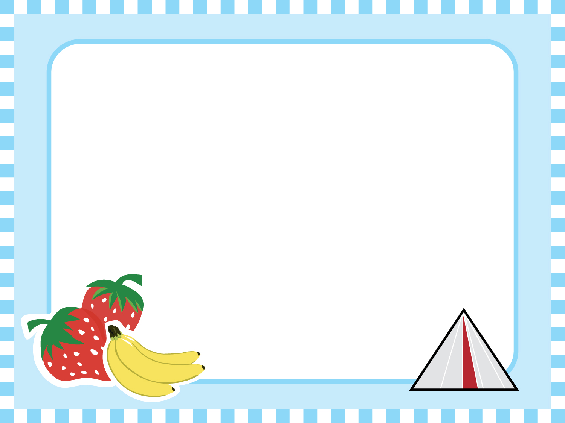
Kitchen Equipment
-Convection bake is: an oven that cooks food faster than a normal conventional bake oven. It has a fan in the back of the oven that circulates air.
-Conventional bake is: an oven that cooks food as a normal recipe states. There is a heat source on the bottom of the oven that cooks the food.

Slide 9
Kitchen Equipment
Go to the kitchen and learn how to work the following:
- Oven (Convention & Broiler)
- Microwave (Set the timer & cook)
- Range (Use all the burners)
- Garbage disposal
- Kitchen Aide Mixer

Slide 10
Cream To soften solid fats, often by adding a second ingredient, such as sugar.
Whip To beat rapidly and make light and airy (Example: egg whites, whipping cream)
Fold To gently combine two mixtures by cutting down through the center with a rubber scraper, across the bottom of the bowl, and up and over close to the surface
Cut-in To mix shortening and flour with a pastry blender or two knives
Knead To work or press dough with the palms of the hands
Sautee To cook in a small amount of fat
Boil To cook a liquid until bubbles rise continuously and break the surface
Simmer To heat to just below boiling
Grate To rub on a tool that separates or shreds the food in various small sizes

Slide 11
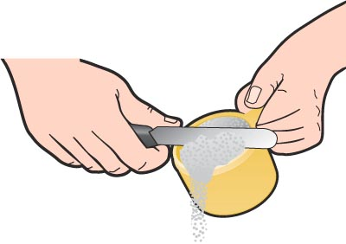
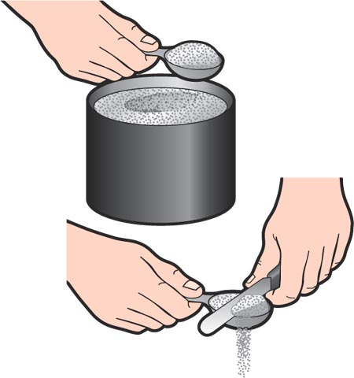
Measuring Dry Ingredients
For dry ingredients including flour, sugar, and salt, use dry measuring cups & spoons.
Heap
Level
Empty
dry measuring cups

Slide 12
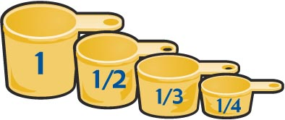
Measuring Solid Ingredients
For solid ingredients including peanut butter, shortening and brown sugar use dry measuring cups.
Pack
Level
Empty

Slide 13
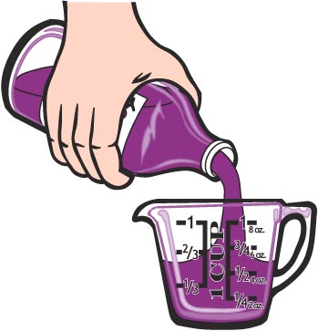
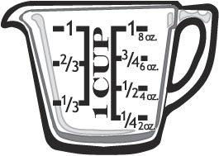
Measuring Liquids
For liquid ingredients including milk, water, oil, and juice, use liquid measuring cups.
Set cup on a flat surface.
Bend down to eye level and pour until the desired mark is reached.
liquid measuring cup

Slide 14
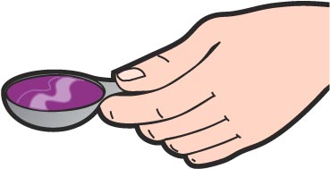
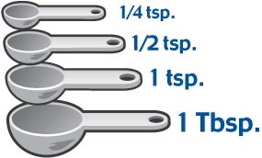
Using Measuring Spoons
Use measuring spoons to measure small amounts of dry and liquid ingredients. Do not use kitchen spoons, they are not accurate.

Slide 15
Water Displacement Method
To use this method:
If you want one cup of shortening, fill up a liquid measuring cup with ½ cup water. Start spooning shortening into the cup until the water reaches 1 ½ cups.

Slide 16
TBS or T= Tablespoon | Pkg= Package | #= Number
Tsp or t= Teaspoon | Bu= Bundle or Bunch | Fl. oz.= Fluid Ounce
C= Cup | Oz= Ounce | Sq= Square
F.G.= Few Grains | Lb= Pound | Gal= Gallon
*C= Celsius | Min= Minute | G= Gram
*F= Ferenheight | Hr= Hour
Pt.= Pint | Mod.= Moderate
Qt.= Quart | Doz= Dozen

Slide 17
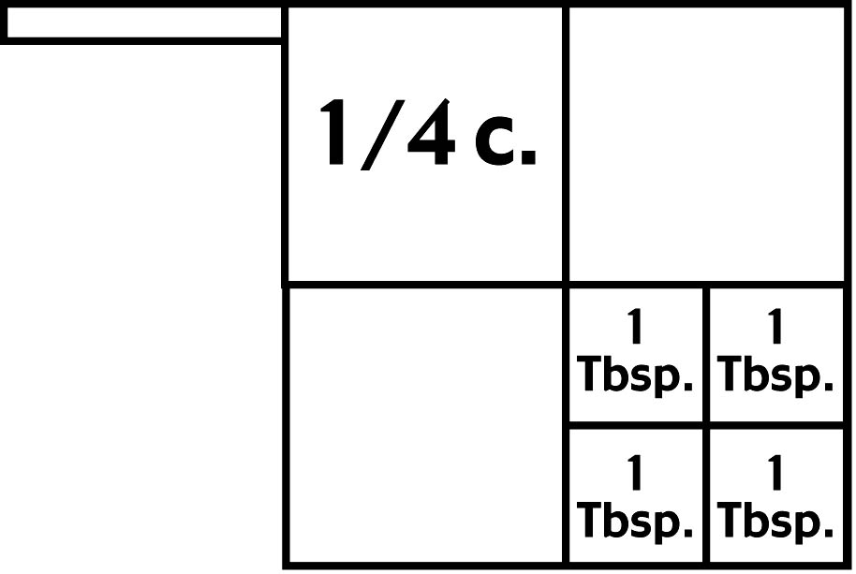
Equivalents
From small to large measurements:
1 Tbsp. = 3 tsp.
1 c. = 16 Tbsp.
2 c. = 1 pt.
4 c. = 1 qt.
16 c. = 1 gal.
2 pt. = 1 qt.
4 qt. = 1 gal.

