Slide 1
Diego Rivera

Slide 3
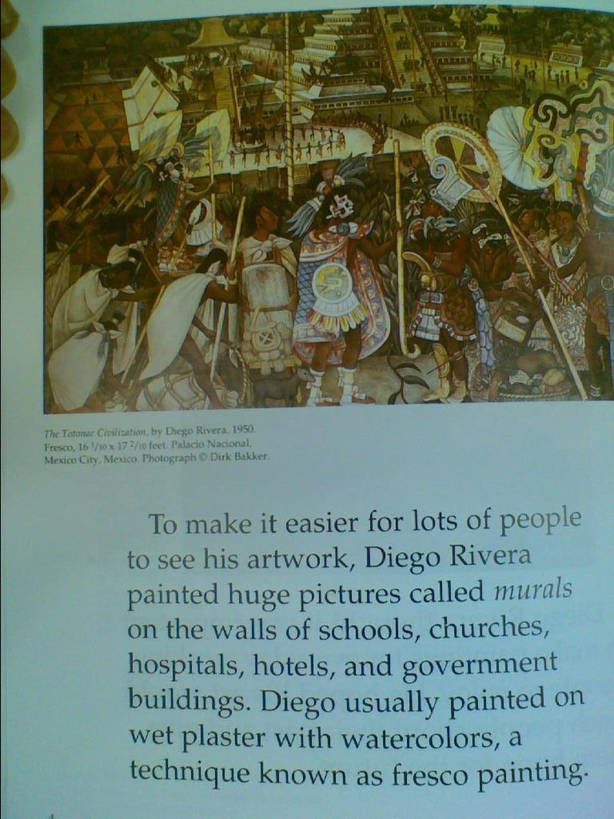

Slide 26
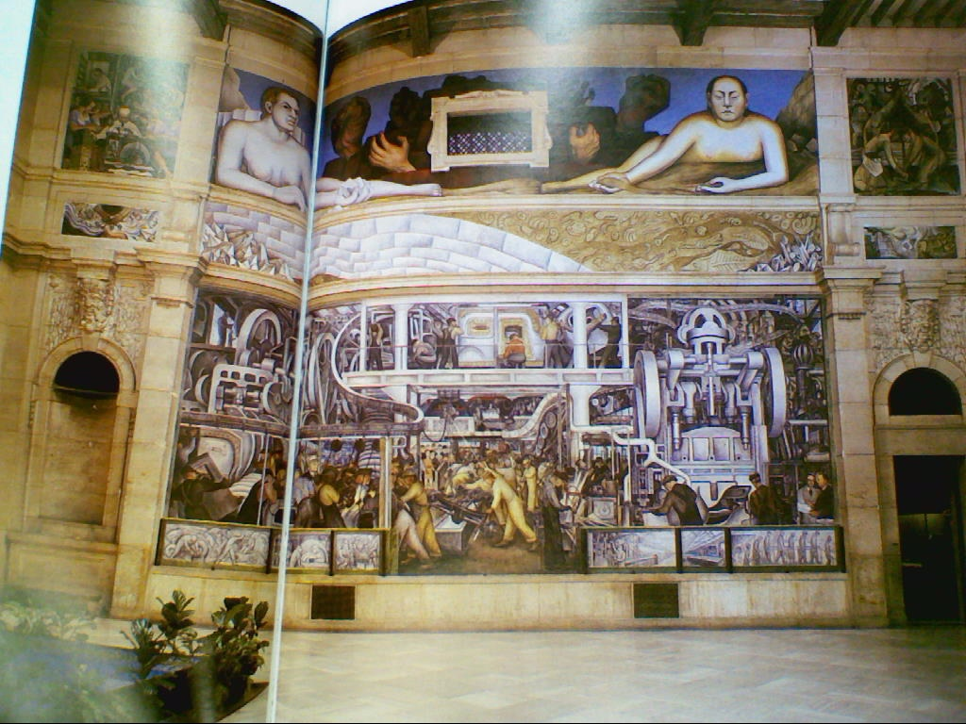

Slide 27
